Slide 1
7ET023 - Dissertation
SQL Injection: - The popular methods, solutions and is it still an issue

Slide 2
Objectives
Research SQL Injection
Popular attacking methods
Popular defensive solutions
Test popular DBMS against SQLIA
Without researched solutions
With researched solutions
Produce report
Based on research and testing

Slide 3
Research Outcomes
Popular attacking methods
Tautologies, piggy-backed queries, Union queries, Blind injection, illegal-logically incorrect queries, stored procedure, timing attacks, alternate encodings
Popular defensive solutions
Defensive coding
Frameworks
Vulnerability scanners
Database firewalls
Encryption

Slide 4
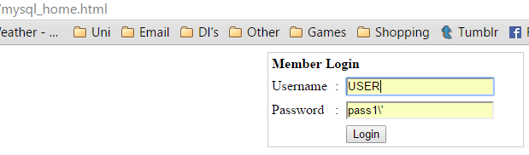
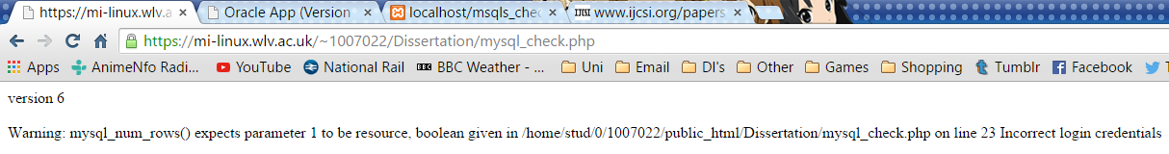
Testing outcomes - MySQL

Slide 5
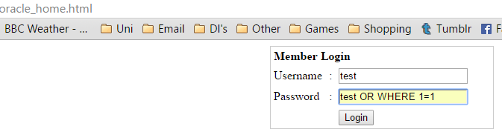
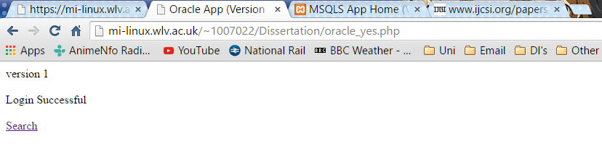
Testing outcomes - Oracle

Slide 6
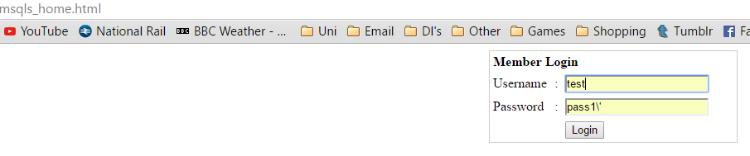
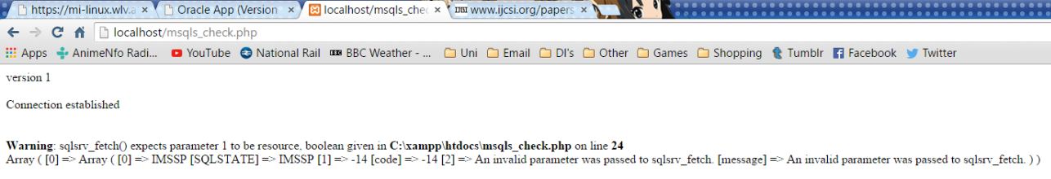
Testing outcomes – Microsoft SQL Server

Slide 7
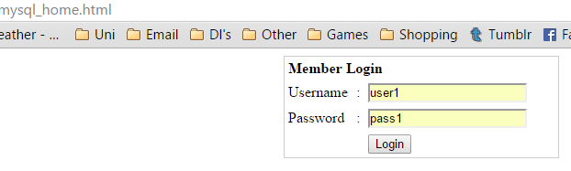
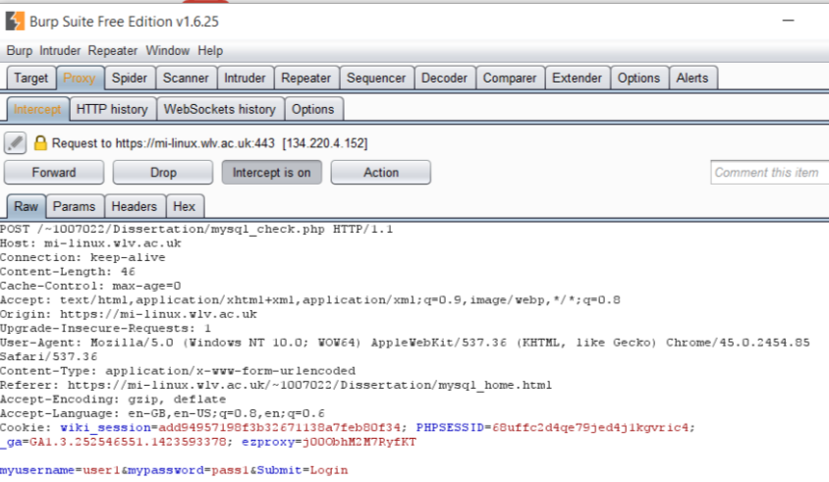
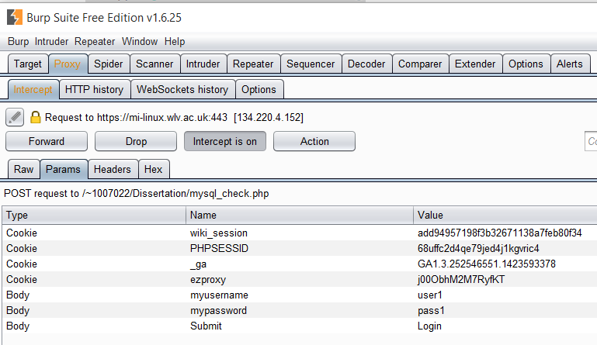
Testing outcomes – Burp Suite

Slide 8
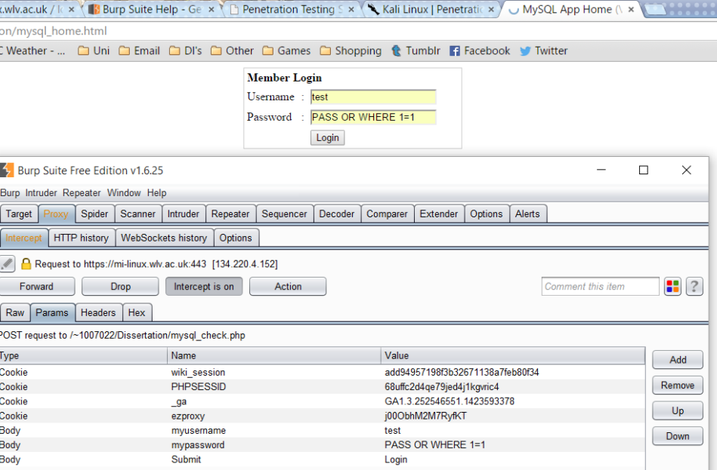
Testing outcomes – Burp Suite

Slide 9
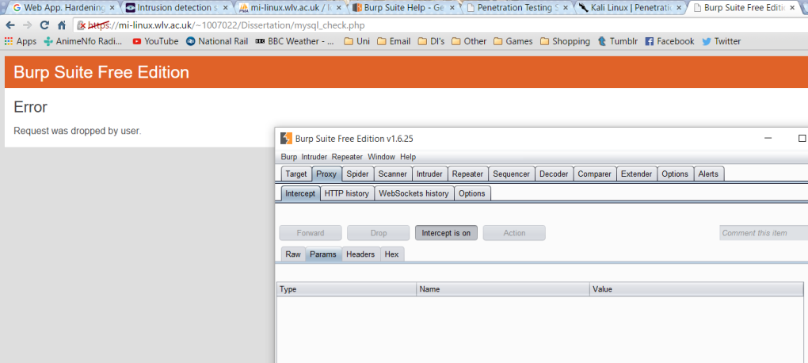
Testing outcomes – Burp Suite

Slide 10
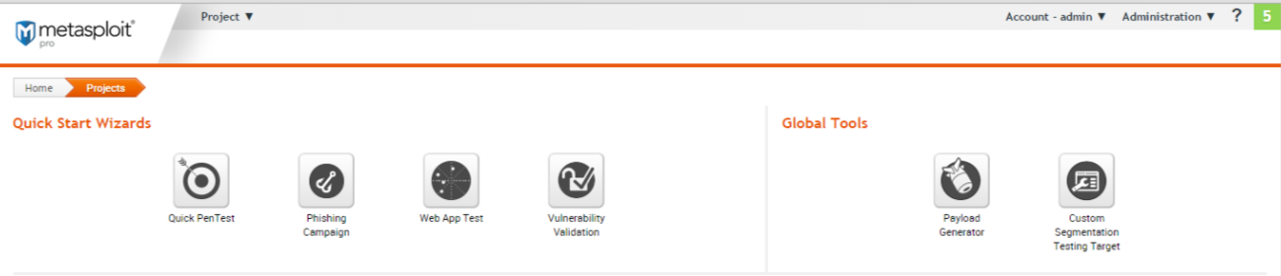
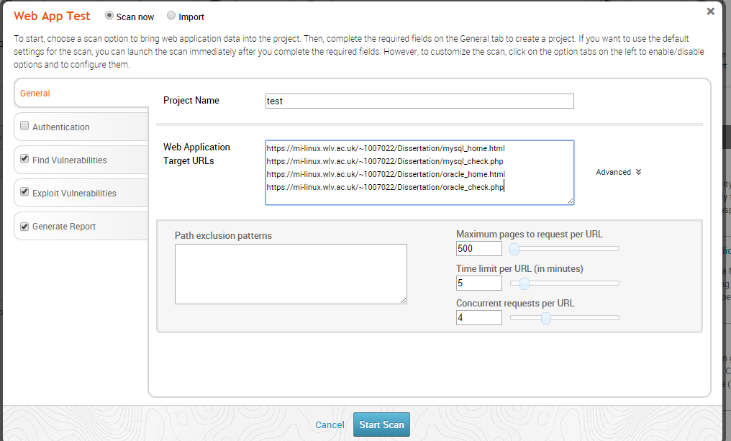
Testing outcomes – Metasploit

Slide 11
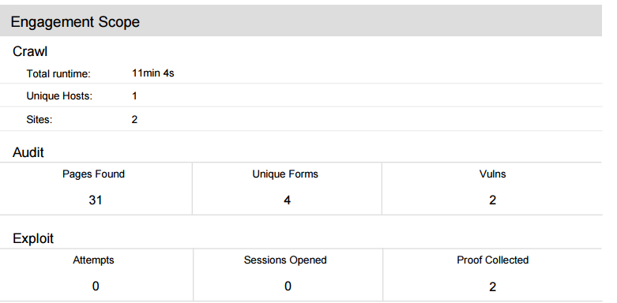
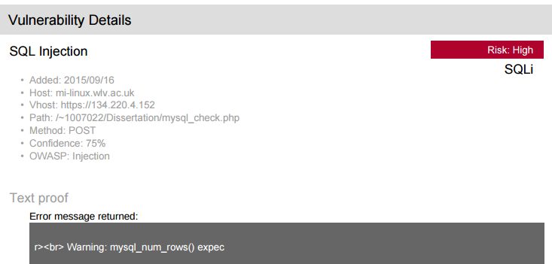
Testing outcomes – Metasploit

Slide 12
Report outcomes
MySQL database most resilient
Oracle and Microsoft SQL Server still vulnerable
Defensive solutions very effective
SQLIA still an issue but in a much reduced state

Slide 13
Artefact
https://mi-linux.wlv.ac.uk/~1007022/Dissertation/mysql_home.html
https://mi-linux.wlv.ac.uk/~1007022/Dissertation/oracle_home.html
PASS OR WHERE 1=1
PASS1\’
1 UNION ALL SELECT PASSWORD FROM SQLI
1; DROP TABLE SQLI
TEST AND 1=1
TEST AND 1=0

